Slide 1

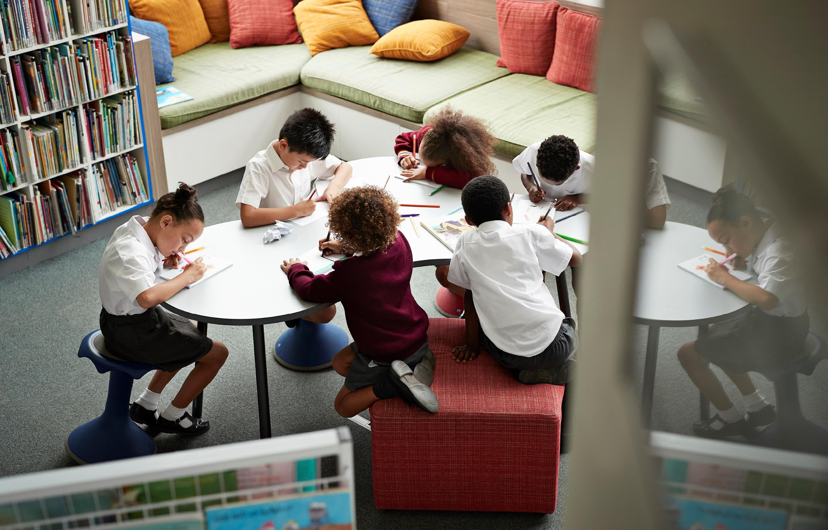
Thought of the week…
What do British Values mean
to you?
©VotesforSchools2023
Notes:
Images
Microsoft Office 365

Slide 2


Be informed: What’s the meaning?
Today, we’re going to talk about British Values. You may have heard about these in the classroom or in everyday life!
These are five values that the Government decided are important to people living in the UK today.
Notes:
Images
Microsoft Office 365
References
https://www.gov.uk/government/news/guidance-on-promoting-british-values-in-schools-published
https://www.bucks.ac.uk/study/apprenticeships/safeguarding-student-welfare/examples-british-values#:~:text=What%20are%20British%20Values%3F,Respect%20and%20Tolerance%2C%20Individual%20Liberty.

Slide 3
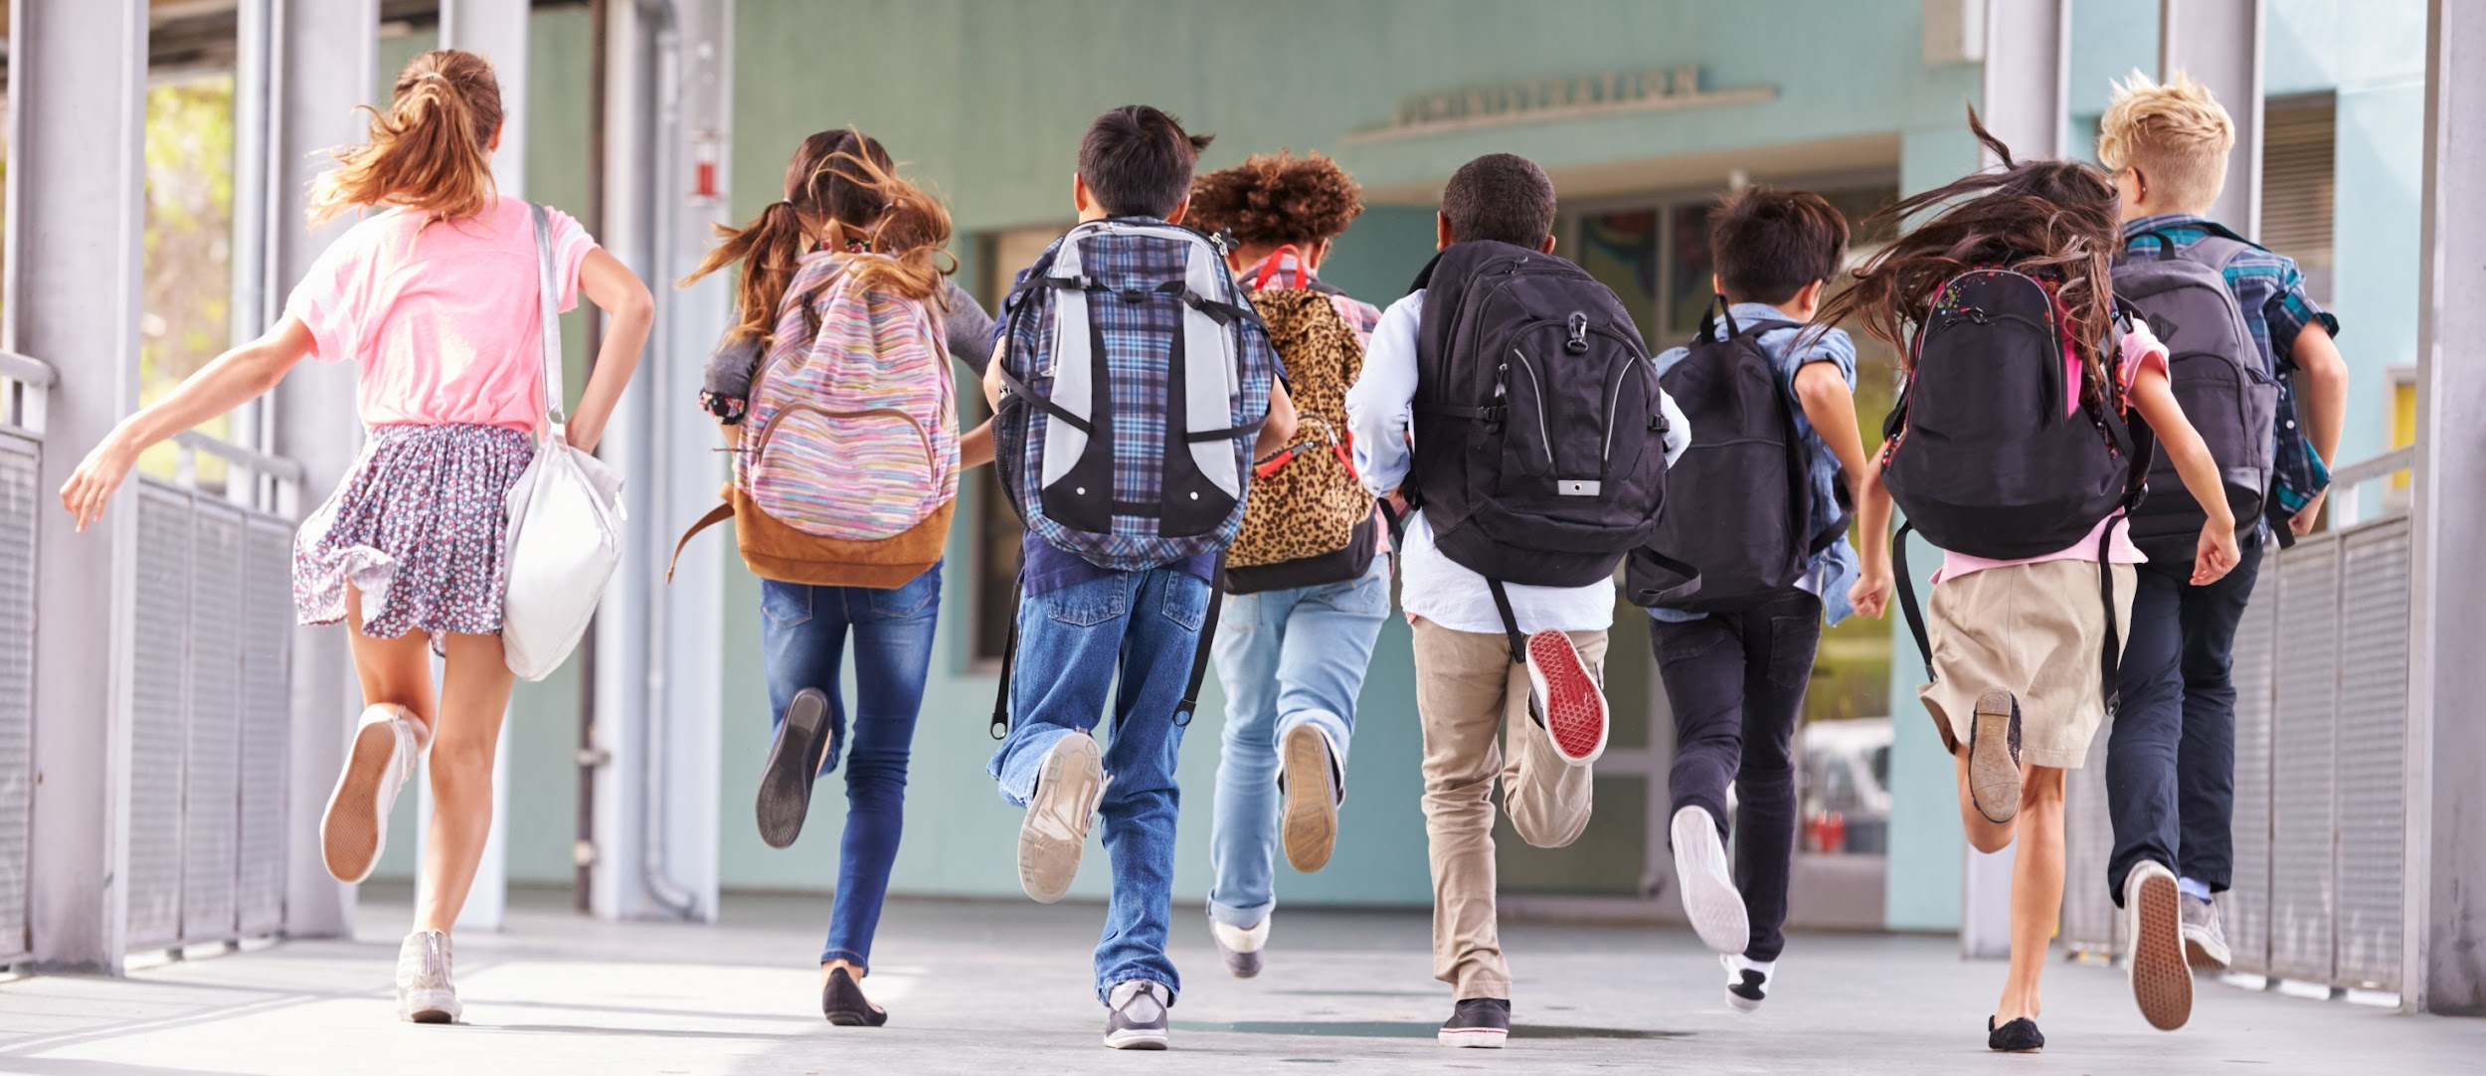
Be informed: What’s the meaning?
In 2014, the Government asked schools to teach young people about British Values.
They hoped that it would help young people to feel ready for life after leaving school.
Notes:
Images
Microsoft Office 365
References
https://dictionary.cambridge.org/dictionary/learner-english/promote
https://www.gov.uk/government/news/guidance-on-promoting-british-values-in-schools-published

Slide 4


Be curious: Finding the value
30-second reflection…
Look at the five British Values and think about their meaning.
Democracy
The rule of law
Individual liberty
Guessing game…
Over the next few slides, use the picture to complete each word to reveal the British Value.
Mutual respect
Tolerance
©VotesforSchools2023
Notes:
Images
Pixabay
References
https://www.gov.uk/government/news/guidance-on-promoting-british-values-in-schools-published

Slide 5

Be curious: Finding the value
D _ _ _ _ _ _ _ _
©VotesforSchools2023
Notes:
Images
Pixabay
Microsoft Office 365
References
https://kids.britannica.com/kids/article/democracy/352935#:~:text=word%20democracy%20describes%20a%20form,rules%20about%20who%20can%20vote.
https://www.gov.uk/government/news/guidance-on-promoting-british-values-in-schools-published

Slide 6
Be curious: Finding the value
Democracy
When people have a say in how the Government run the country.
©VotesforSchools2023
Notes:
Images
Pixabay
Microsoft Office 365
References
https://kids.britannica.com/kids/article/democracy/352935#:~:text=word%20democracy%20describes%20a%20form,rules%20about%20who%20can%20vote.
https://www.gov.uk/government/news/guidance-on-promoting-british-values-in-schools-published

Slide 7
Be curious: Finding the value
Democracy
How do we show democracy at St Mary’s?
Weekly Debate
Pupil ambassadors
©VotesforSchools2023
Notes:
Images
Pixabay
Microsoft Office 365
References
https://kids.britannica.com/kids/article/democracy/352935#:~:text=word%20democracy%20describes%20a%20form,rules%20about%20who%20can%20vote.
https://www.gov.uk/government/news/guidance-on-promoting-british-values-in-schools-published

Slide 8

Be curious: Finding the value
The Rule of L _ _
©VotesforSchools2023
Notes:
Images
Pixabay
Microsoft Office 365
References
https://dictionary.cambridge.org/dictionary/learner-english/law
https://www.gov.uk/government/news/guidance-on-promoting-british-values-in-schools-published

Slide 9
Be curious: Finding the value
The Rule of Law
Following the rules that are in place in the UK.
©VotesforSchools2023
Notes:
Images
Pixabay
Microsoft Office 365
References
https://dictionary.cambridge.org/dictionary/learner-english/law
https://www.gov.uk/government/news/guidance-on-promoting-british-values-in-schools-published

Slide 10
Be curious: Finding the value
The Rule of Law
How do we follow rules at St Mary’s?
Classroom rules
School mission - Live, Love, Believe
Beehaviour code - Be kind, Be respectful, Be ready
©VotesforSchools2023
Notes:
Images
Pixabay
Microsoft Office 365
References
https://dictionary.cambridge.org/dictionary/learner-english/law
https://www.gov.uk/government/news/guidance-on-promoting-british-values-in-schools-published

Slide 11

Be curious: Finding the value
Individual L _ _ _ _ _ _
©VotesforSchools2023
Notes:
Images
Pixabay
Microsoft Office 365
References
https://dictionary.cambridge.org/dictionary/learner-english/liberty
https://www.gov.uk/government/news/guidance-on-promoting-british-values-in-schools-published

Slide 12
Be curious: Finding the value
Individual Liberty
The freedom to make choices about your life.
©VotesforSchools2023
Notes:
Images
Pixabay
Microsoft Office 365
References
https://dictionary.cambridge.org/dictionary/learner-english/liberty
https://www.gov.uk/government/news/guidance-on-promoting-british-values-in-schools-published

Slide 13
Be curious: Finding the value
Individual Liberty
Do you make choices at St Mary’s?
Pupil Voice
Fundraising
Challenge in lessons
Friendships
Behaviour choices
©VotesforSchools2023
Notes:
Images
Pixabay
Microsoft Office 365
References
https://dictionary.cambridge.org/dictionary/learner-english/liberty
https://www.gov.uk/government/news/guidance-on-promoting-british-values-in-schools-published

Slide 14

Be curious: Finding the value
Mutual R _ _ _ _ _ _
©VotesforSchools2023
Notes:
Images
Pixabay
Microsoft Office 365
References
https://www.bbc.co.uk/teach/school-radio/assemblies-ks1-ks2-british-values-mutual-respect/zp8yhcw
https://www.gov.uk/government/news/guidance-on-promoting-british-values-in-schools-published

Slide 15
Be curious: Finding the value
Mutual Respect
To show we value each other by behaving in a polite and thoughtful way.
©VotesforSchools2023
Notes:
Images
Pixabay
Microsoft Office 365
References
https://www.bbc.co.uk/teach/school-radio/assemblies-ks1-ks2-british-values-mutual-respect/zp8yhcw
https://www.gov.uk/government/news/guidance-on-promoting-british-values-in-schools-published

Slide 16
Be curious: Finding the value
Mutual Respect
How do people show mutual respect at St Mary’s?
Equality and diversity ambassadors
Beehaviour code
PSHE lessons
©VotesforSchools2023
Notes:
Images
Pixabay
Microsoft Office 365
References
https://www.bbc.co.uk/teach/school-radio/assemblies-ks1-ks2-british-values-mutual-respect/zp8yhcw
https://www.gov.uk/government/news/guidance-on-promoting-british-values-in-schools-published

Slide 17

Be curious: Finding the value
T _ _ _ _ _ _ _ _ of those with different faiths and beliefs
©VotesforSchools2023
Notes:
Images
Pixabay
Microsoft Office 365
References
https://www.bucks.ac.uk/study/apprenticeships/safeguarding-student-welfare/examples-british-values#:~:text=Codes%20of%20conduct-,Respect%20and%20Tolerance,Examples
https://www.gov.uk/government/news/guidance-on-promoting-british-values-in-schools-published

Slide 18
Be curious: Finding the value
Tolerance of those with different faiths and beliefs
Understanding and respecting that everyone has different views and beliefs.
©VotesforSchools2023
Notes:
Images
Pixabay
Microsoft Office 365
References
https://www.bucks.ac.uk/study/apprenticeships/safeguarding-student-welfare/examples-british-values#:~:text=Codes%20of%20conduct-,Respect%20and%20Tolerance,Examples
https://www.gov.uk/government/news/guidance-on-promoting-british-values-in-schools-published

Slide 19
Be curious: Finding the value
Tolerance of those with different faiths and beliefs
PSHE lessons, Street food market, languages day, RE lessons
©VotesforSchools2023
Notes:
Images
Pixabay
Microsoft Office 365
References
https://www.bucks.ac.uk/study/apprenticeships/safeguarding-student-welfare/examples-british-values#:~:text=Codes%20of%20conduct-,Respect%20and%20Tolerance,Examples
https://www.gov.uk/government/news/guidance-on-promoting-british-values-in-schools-published

Slide 20


Be heard: Everyday values
As well as knowing the meaning of each British Value, it’s important that we know how they play a role in our daily lives.
Thinking it over…
Let’s look at some ways you might see the British Values at work each day in school.
©VotesforSchools2023
Notes:
Images
iStock

Slide 21



Be heard: Everyday values
Have conversations
Talking to and listening to others allows us to learn so much about each other!
©VotesforSchools2023
Notes:
Images
Microsoft Office 365
iStock
References
https://www.votesforschools.com/teacher-toolkit/british-values-smsc-prevent/embedding-british-values/

Slide 22

Be heard: Everyday values
School trips
Going on trips is not only fun, but educational too! Visiting places of worship is a great way to learn more about different faiths and beliefs.
©VotesforSchools2023
Notes:
Images
Microsoft Office 365
iStock
References
https://www.votesforschools.com/teacher-toolkit/british-values-smsc-prevent/embedding-british-values/

Slide 23

Be heard: Everyday values
School ambassadors
Ambassadors allow you to take part in elections and make sure your voice is heard to create change!
©VotesforSchools2023
Notes:
Images
Microsoft Office 365
iStock
References
https://www.votesforschools.com/teacher-toolkit/british-values-smsc-prevent/embedding-british-values/

Slide 24



Be heard: Everyday values
Keep up with the news
Taking part in VotesforSchools lessons or watching Newsround allows you to learn more about the world around you!
©VotesforSchools2023
Notes:
Images
Microsoft Office 365
iStock
References
https://www.votesforschools.com/teacher-toolkit/british-values-smsc-prevent/embedding-british-values/

