Slide 1



Our Weekly debate
Capturing pupil voice at St Mary’s Primary School
LIVE LOVE BELIEVE

Slide 2
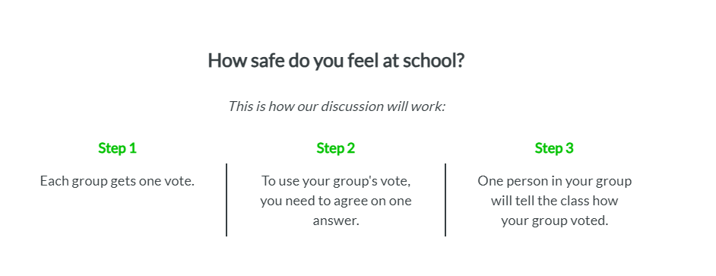
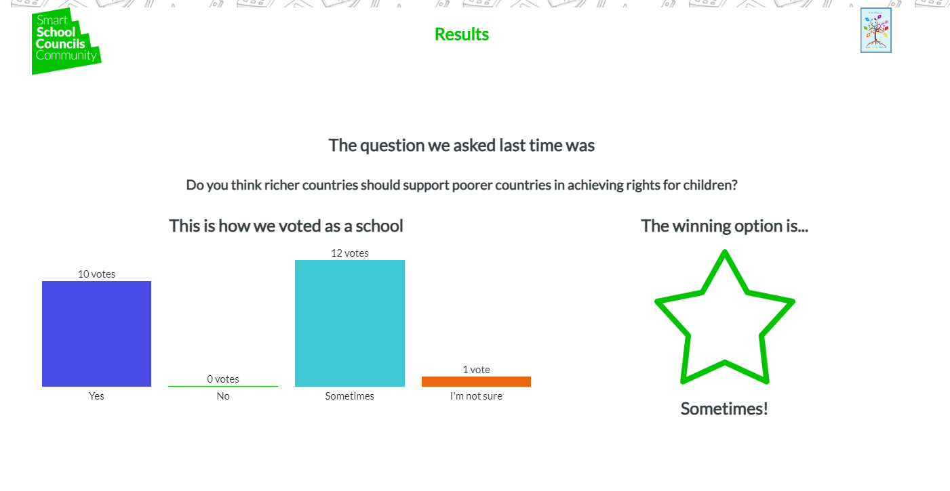
We hold a class debate every week!
A question is set and as a class we discuss this and then work in teams to decide on a group answer.
This is then recorded and stored so we can look back on what we decided as a whole school
We also record our thoughts and ideas about the question. Our EARA (Equality and rights advocate) group then discuss these and decide if anything else needs to be put in place within our school. You can see some examples on the next page!

Slide 3
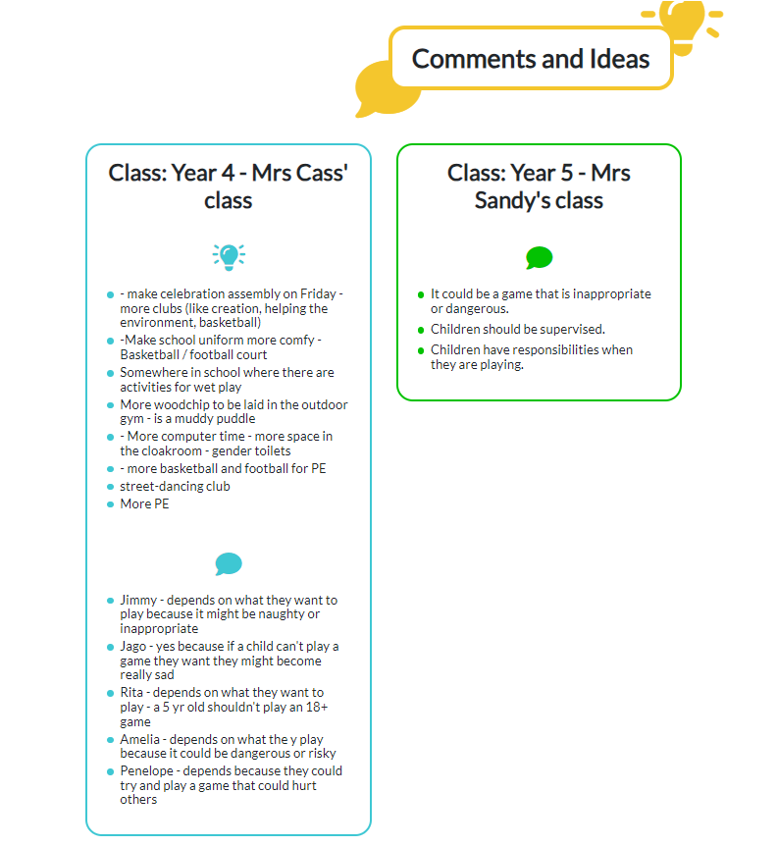
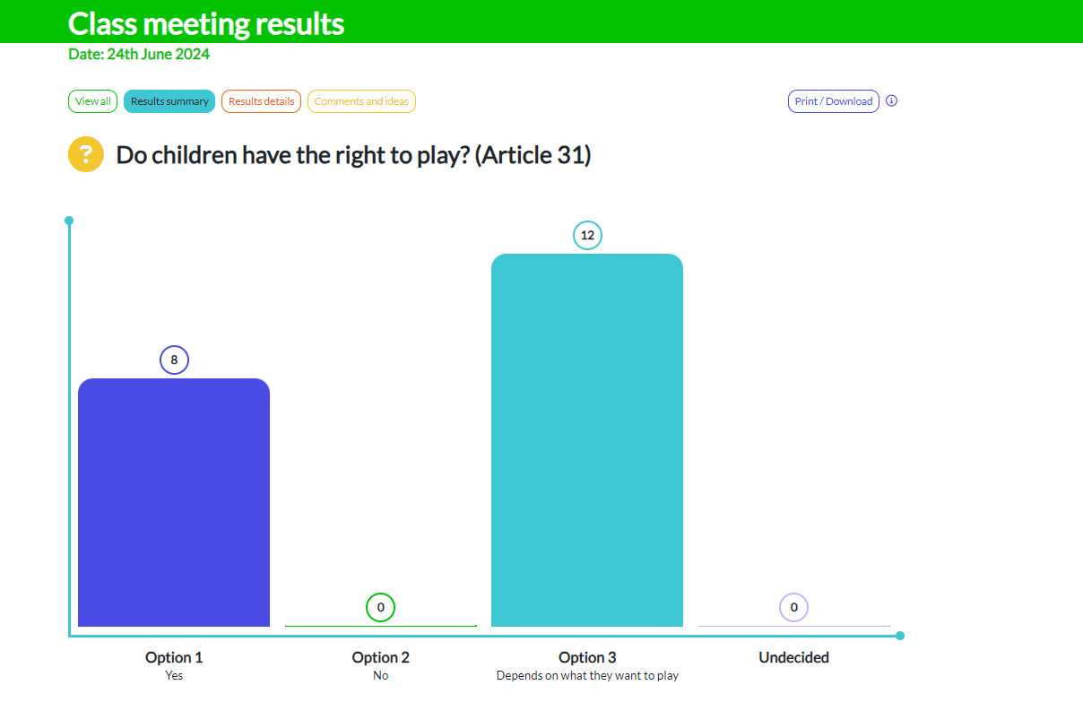
Here are some of our debates and the results!
Here is the whole school’s views all together!
Here are some of our responses/ ideas generated from the original question

Slide 4
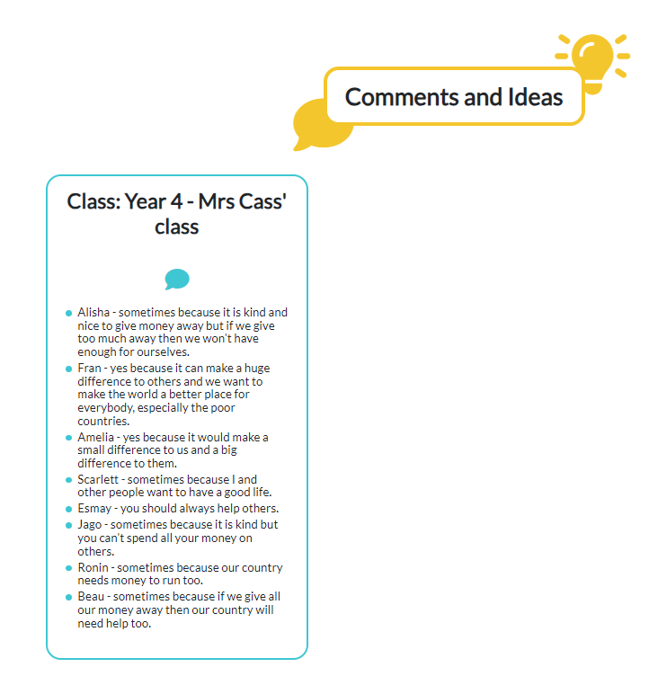
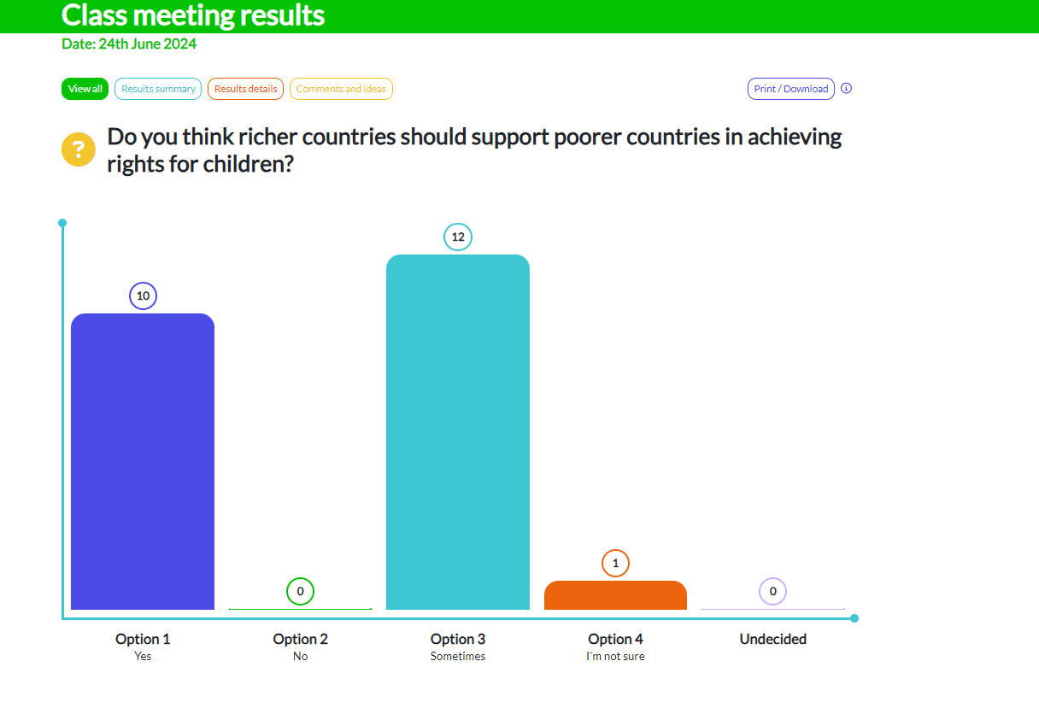

Slide 5
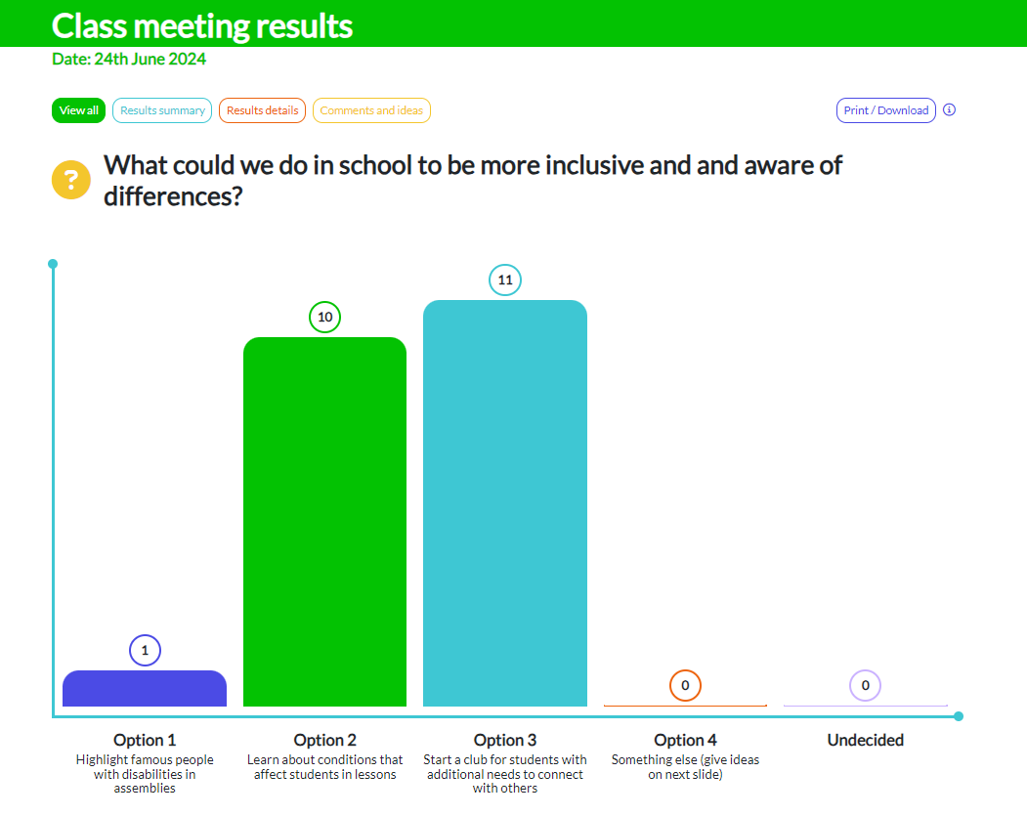

Slide 6
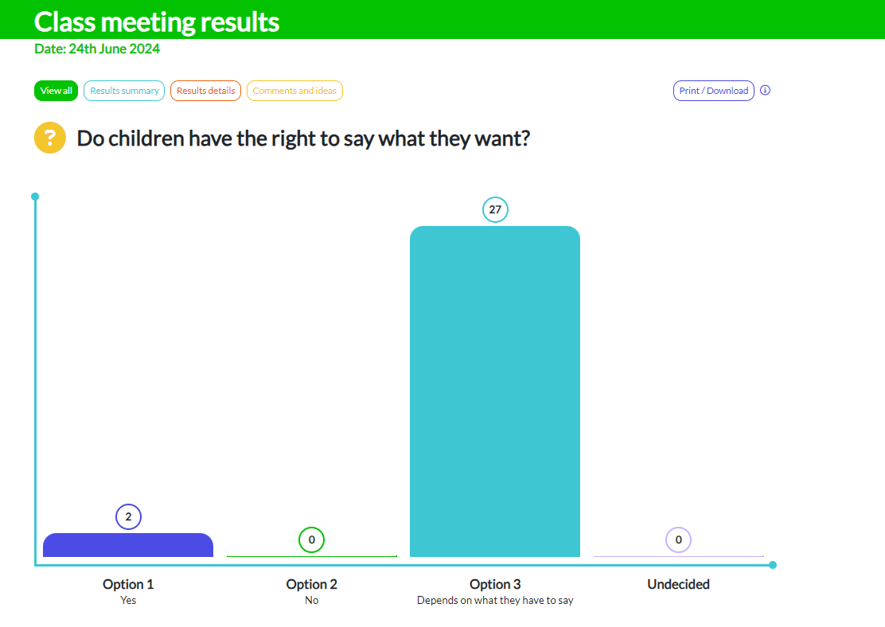
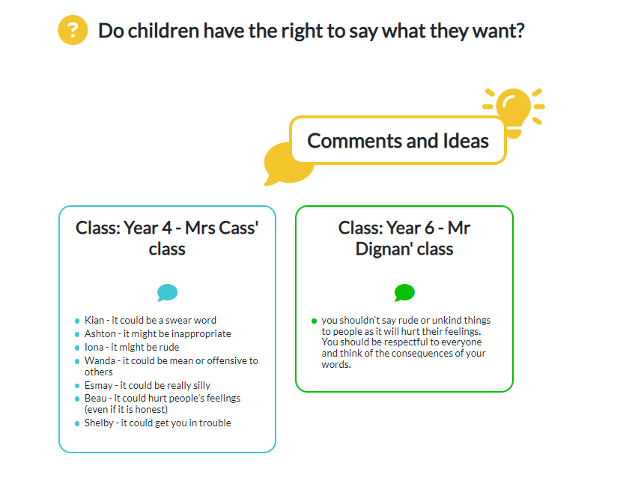

Slide 7
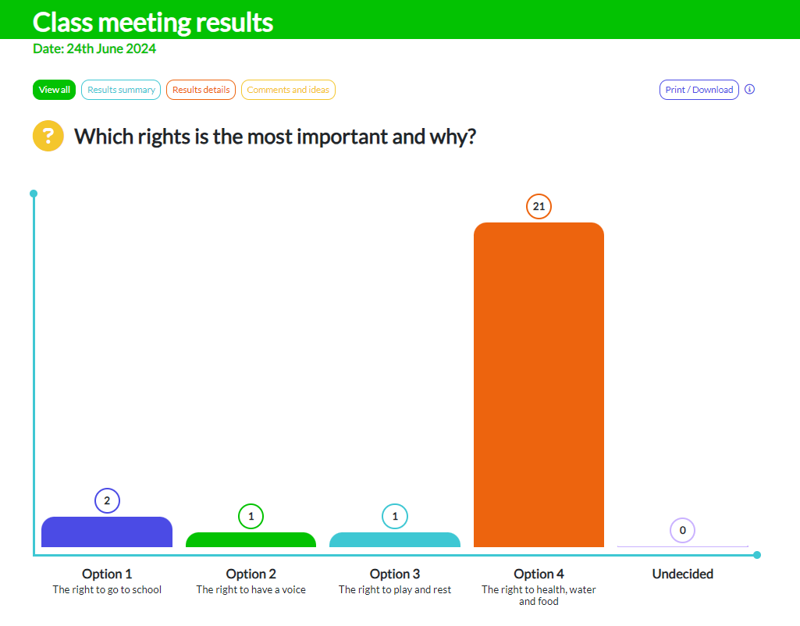
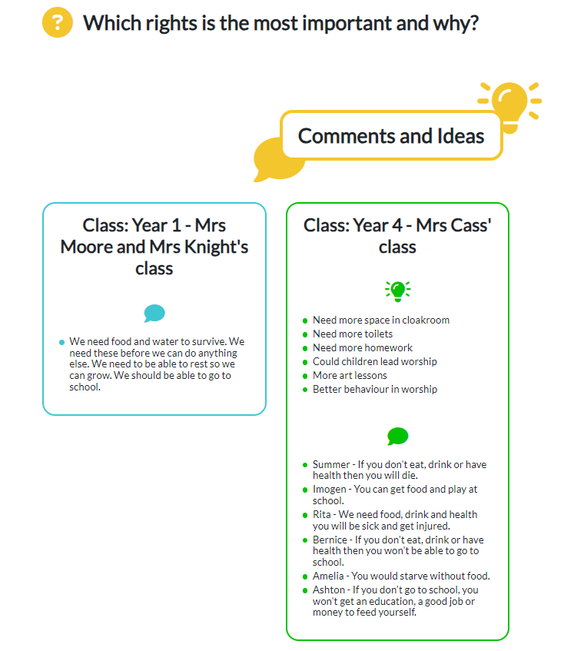

Slide 8
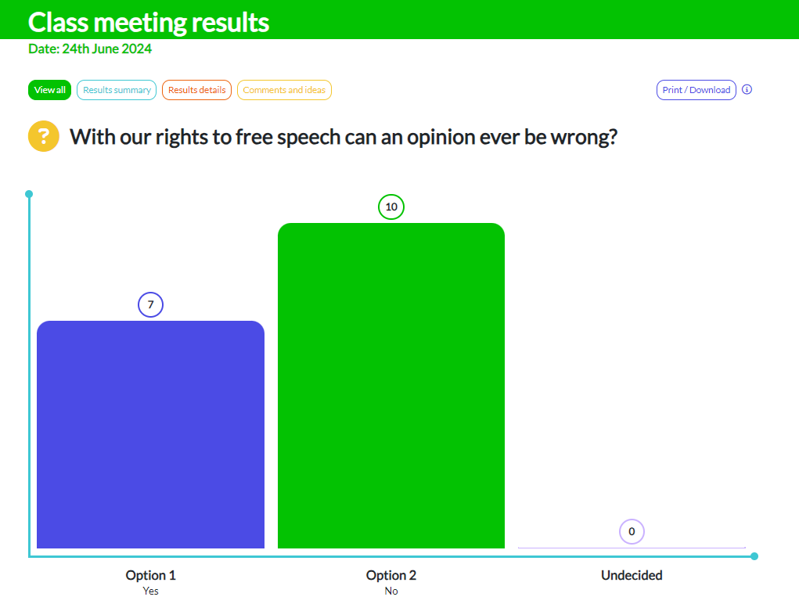
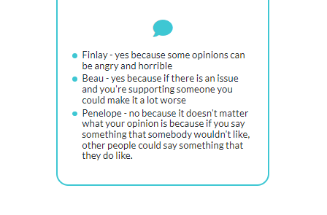

Slide 9


